Slide 1


Inflation in Singapore
Name : Divyesh Jhunjhunwala, Roll No : 23052964
Section : CSE-25

Slide 2

Definition and Concept of Inflation
Inflation is defined by the IMF as a sustained increase in the general price level of goods and services in an economy. The Consumer Price Index (CPI) measures inflation through changes in consumer prices.

Slide 3
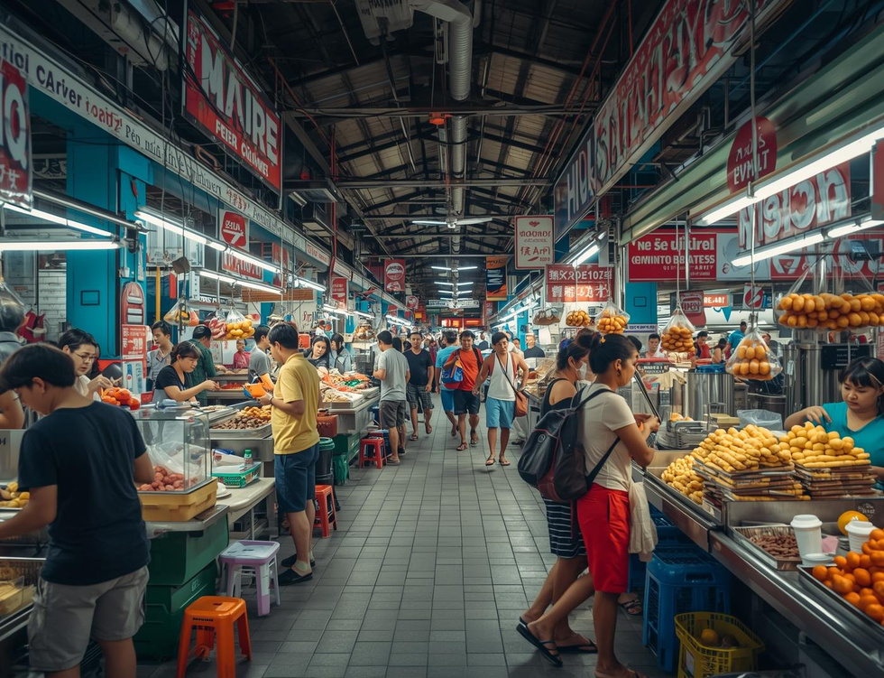

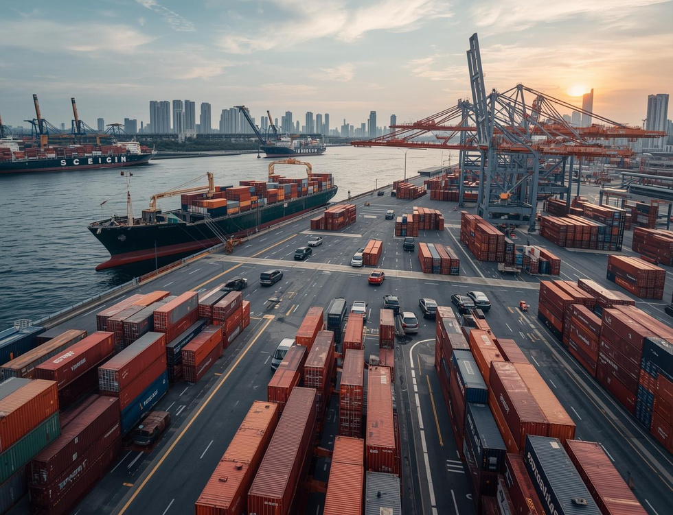
Types of Inflation
Demand-Pull
Cost-Push
Imported Inflation
Increased consumer spending post-pandemic drives demand-pull inflation, raising prices across sectors.
Rising global oil prices lead to higher production costs, causing cost-push inflation in Singapore.
Dependency on imported goods for essentials like food and fuel contributes to imported inflation pressures.

Slide 4

Causes of Inflation in Singapore
Inflation in Singapore is driven by several key factors including global oil price fluctuations, supply chain disruptions from the pandemic, a tight labor market causing wage pressures, and depreciation of the SGD.

Slide 5
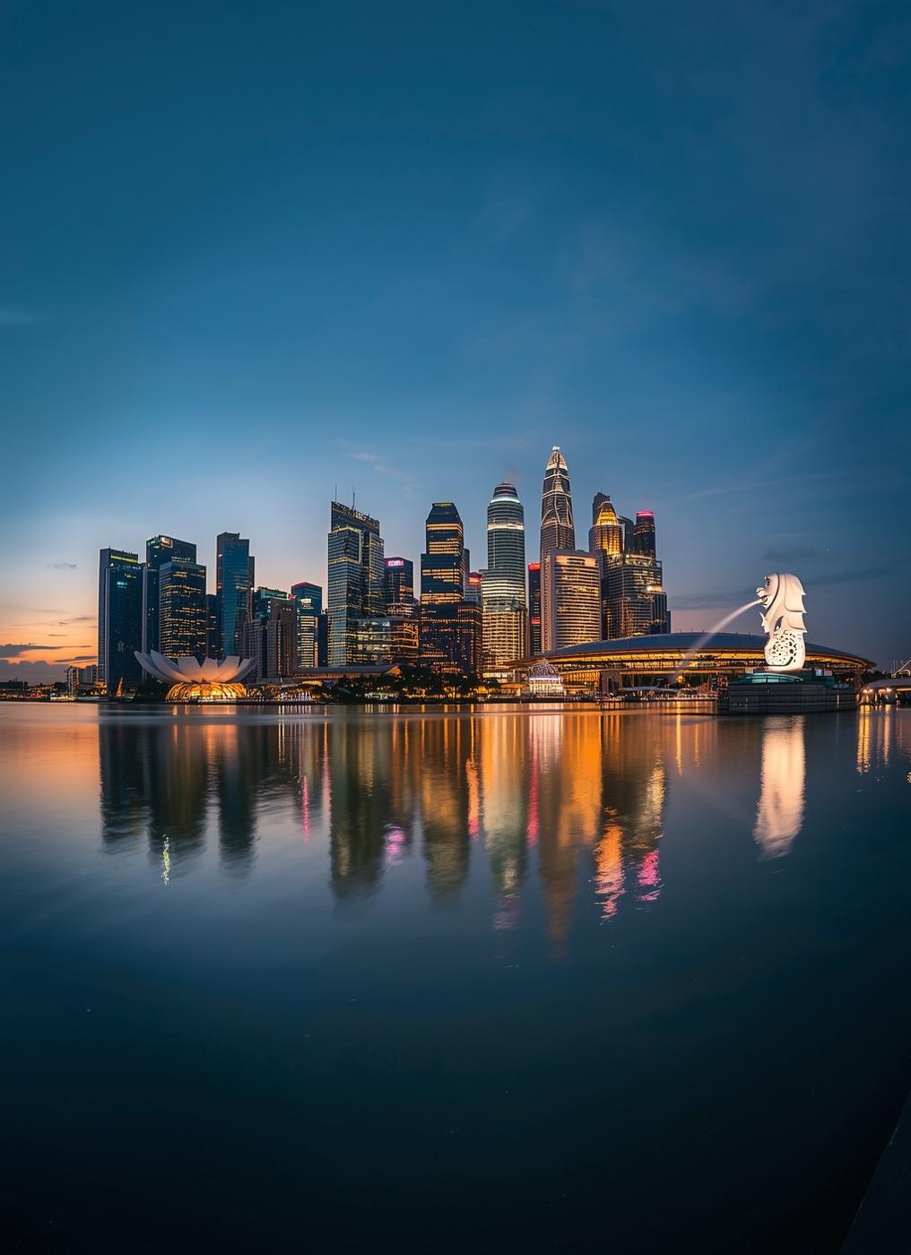
Annual CPI Trends
Between 2019 and 2020, Singapore experienced low inflation rates, From 2019 to 2024, Singapore’s inflation showed notable shifts influenced by global and domestic factors. Inflation was low at 0.6% in 2019, then turned slightly negative in 2020 (–0.2%) due to weak demand during the pandemic. It rose to 2.3% in 2021 as the economy reopened and supply chains tightened, before peaking at 6.1% in 2022 amid global energy and food price spikes. With the Monetary Authority of Singapore (MAS) tightening policy and supply conditions improving, inflation eased to 4.8% in 2023 and is projected to settle around 3.0% in 2024, close to the long-term target range of 2–3%.contributing to economic stability. The Consumer Price Index (CPI) remained relatively stable, reflecting effective monetary policies in response to global economic conditions.

Slide 6

Global Supply Chain Disruptions
The sharp rise in inflation during 2021-2022 can be attributed to significant disruptions in the global supply chain, impacting the availability and costs of goods across various sectors in Singapore.

Slide 7
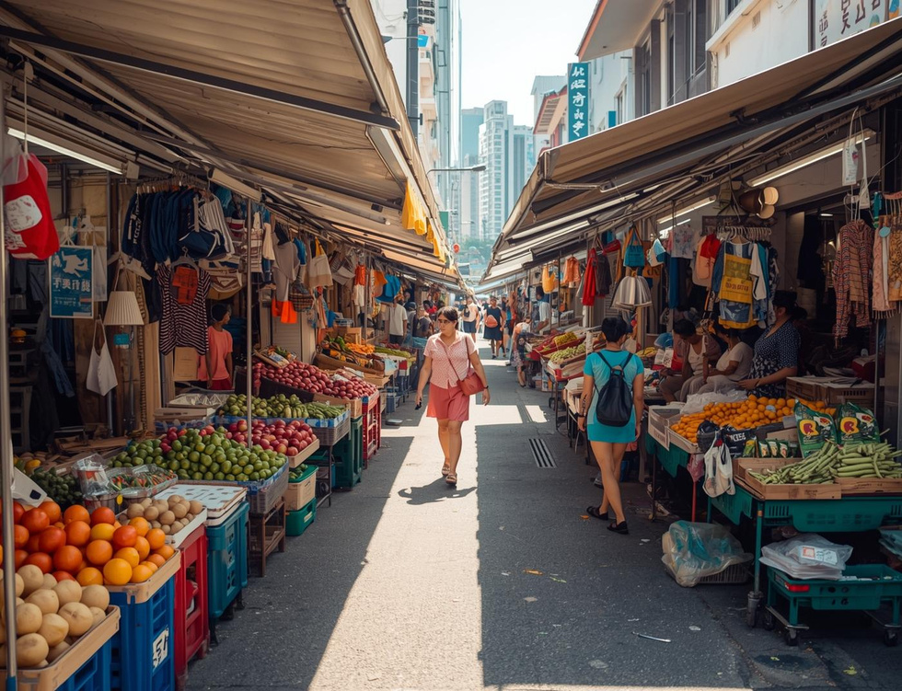


Effects of Inflation
Higher Cost
Impact on SMEs
Wage Pressure
Rising prices have led to increased living costs, affecting households across Singapore.
Small and medium enterprises are struggling to maintain profitability due to rising operational costs.
Inflationary pressures are causing challenges for wage growth, leading to increased income inequality.

Slide 8



Economic Impacts
Effects on Imports
Effects on Exports
Overall Competitiveness
Higher import costs can lead to increased prices for consumers and businesses alike.
Export competitiveness may decline as inflation raises the costs of production for local goods.
Inflation can undermine overall competitiveness, affecting Singapore's position in the global market.

Slide 9
Measures to Control Inflation
Key Strategies Employed in Singapore
Monetary Policy
Government Assistance
Strengthening SGD
The Monetary Authority of Singapore employs an exchange rate-based monetary policy to control inflation, allowing for adjustments to the nominal effective exchange rate to stabilize prices.
Various government support packages, including utilities rebates and grants, help mitigate financial burdens on households while addressing rising costs stemming from inflationary pressures.
Efforts to strengthen the Singapore Dollar (SGD) aim to reduce imported inflation by making imports less expensive, ultimately contributing to a more stable economic environment.
9

Slide 10
Measures to Control Inflation
Government Actions and Support Strategies
Utilities Rebates
Household Grants
Strengthening SGD
The government has implemented utilities rebates to alleviate financial strain on households, helping them manage rising costs of essential services amid inflationary pressures.
Various household grants have been introduced to provide immediate financial aid to families, ensuring they can maintain their living standards during periods of increasing prices.
The Monetary Authority of Singapore is focused on strengthening the SGD to combat imported inflation, enhancing the currency's value to stabilize prices for consumers.
10

Slide 11

Analysis and Conclusion on Inflation
Singapore’s inflation surge was largely externally driven.
MAS and the government acted proactively and effectively to manage it.
Inflation now near long-term average (2–3%), showing policy success
Suggestions:
Enhance food and energy security.
Support productivity growth to offset wage inflation.
Diversify import sources to reduce exposure to global shocks.

Slide 12

Credible Data Sources for Inflation
Monetary Authority of Singapore (MAS) – Inflation Reports (2019–2024)
Singapore Department of Statistics (SingStat)
IMF World Economic Outlook Database (2024)
World Bank Open Data – Inflation Rate (Singapore)
Reuters, Channel NewsAsia – Economic Reports (2023–2024)

